Slide 1
A1 Chemistry
Periodic Table Trends

Slide 3
Learning Intentions
the elements of the periodic table show trends across periods and down main groups, including in atomic radii, valencies, 1st ionisation energy and electronegativity as exemplified by groups 1, 2, 13–18 and period 3

Slide 4
Success criteria
Define atomic radii, valence, 1st ionisation energy, electronegativity, metallicity
describe the pattern or trend across period 3, and down groups 1, 2, 13-18
Explain how successive ionisation energies can be used to determine valence

Slide 5
Key words
atomic radii
valence
(1st) ionisation energy
electronegativity

Slide 6
Atomic radii
What is it? | The size of the atom
Across periods it… | generally decreases, although the noble gases are slightly bigger than the previous atom
because… | increasing positive charge (more protons) in the nucleus attracts electrons more strongly; noble gases have full shells, so their outer shell can’t shrink in too much
Down groups it… | increases
because… | each extra electron shell takes up more space, as well as ‘shielding’ the outer electrons from the positivity of the nucleus

Slide 7
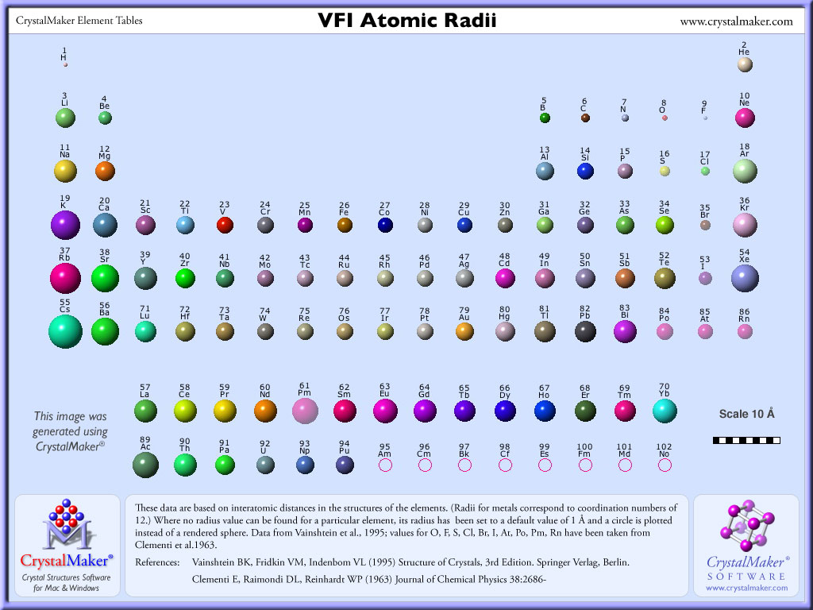

Slide 8
Valence
What is it? | The number of outer shell electrons (which affects charge of ions)
Across periods it… | increases
because… | more outer shell electrons are added
Down groups it… | stays the same, sort of ☺
because… | chemical families share the same number of electrons in their outer shell, or spaces where electrons could be

Slide 9
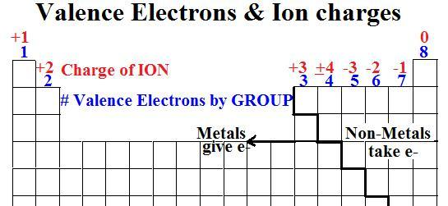

Slide 10
First ionisation energy
What is it? | The amount of energy required to remove one (outermost) electron from an atom
Across periods it… | generally increases; however, there are “spikes”
because… | the increasing positive charge of the nucleus attracts and holds electrons more strongly ; full shells, and to a lesser extent full subshells, are harder to remove electrons from; even ‘half full’ subshells are harder than almost half full
Down groups it… | decreases
because… | the distance from positive nucleus to outermost electron gets bigger and shielding from electron shells decreases the hold on outermost electrons

Slide 11
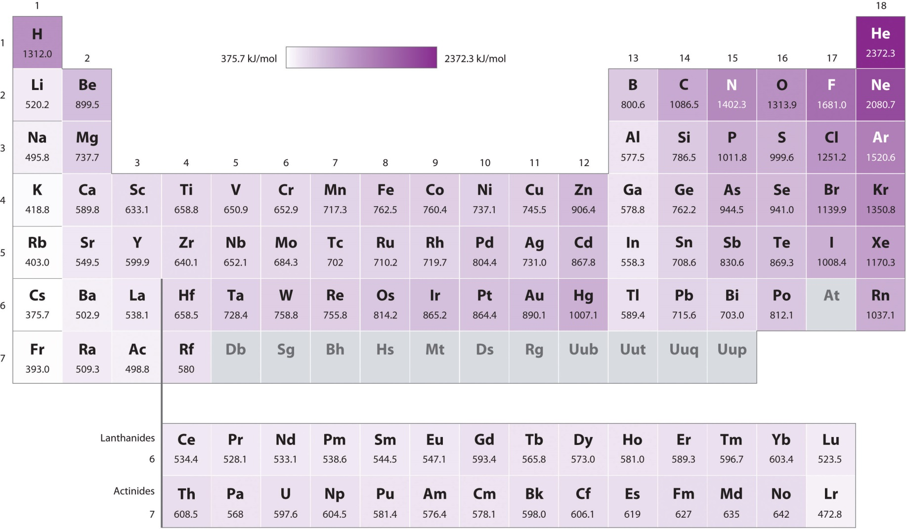

Slide 12
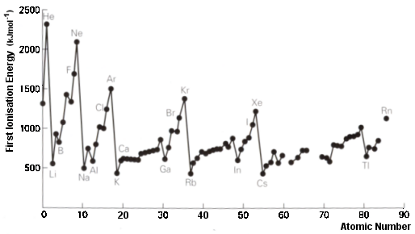

Slide 13
Successive ionisation energies
Having removed one electron, a second electron is harder to remove as the whole atom becomes more and more positive (and therefore attractive to the electrons).
Once all the outer shell electrons are removed, it is significantly harder to remove one from the next full shell.

Slide 14
Electronegativity
What is it? | A measure of how strongly atoms attract electrons, especially within bonds; sometimes thought of as ‘electron density’.
Across periods it… | generally increases; lets ignore noble gases.
because… | the increasing positive charge of the nucleus attracts electrons more strongly
Down groups it… | decreases
because… | the distance from positive nucleus to outermost electrons gets bigger and shielding decreases the attraction of outermost electrons to the nucleus

Slide 15
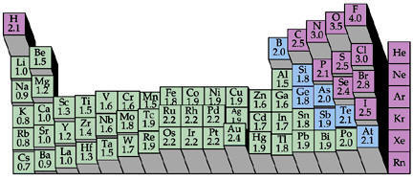

Slide 16
Things with low electronegativity tend to
form positive ions
oxidise readily
react explosively (especially with water)
be soft, shiny, conductive as elemental solids

Slide 17
Things with high electronegativity tend to
form negative ions OR
form covalent bonds
cause other things to oxidise
be corrosive as elemental gases

Slide 18
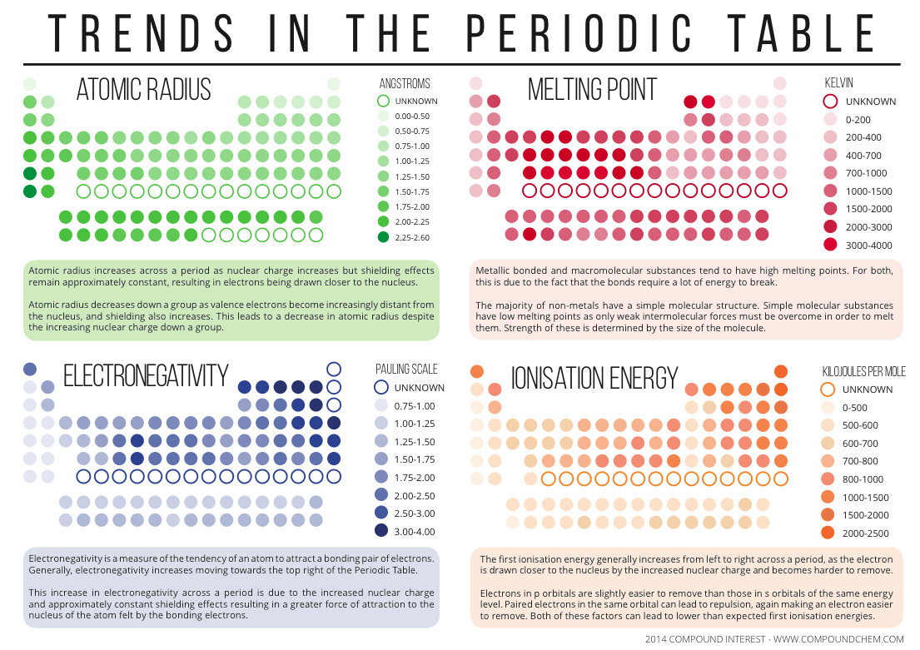

Slide 19
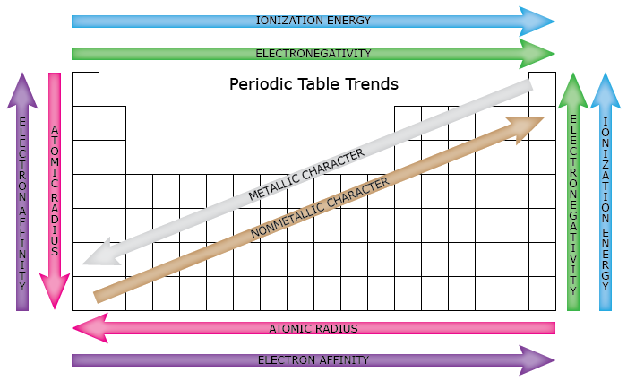

Slide 20
Success criteria
Define atomic radii, valence, 1st ionisation energy, electronegativity, metallicity
describe the pattern or trend across period 3, and down groups 1, 2, 13-18
Explain how successive ionisation energies can be used to determine valence

